Slide 1


The HORN Package Manager
2 options for creating DSLs in .NET

Slide 2


Who Am I?

Slide 3

Why?

Slide 4
Show me the Pain
Notes:
Finish demo here.

Slide 5

We Live On the bleeding Edge

Slide 6
Or Do we?
Notes:
Finish demo here.

Slide 7
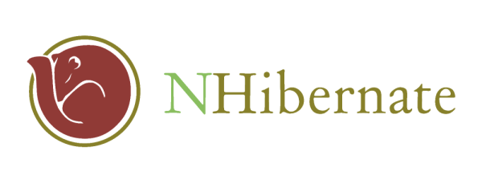



The Usual Suspects
ASP.NET MVCContrib

Slide 8
A typical Scenario
ASP.NET MVC Moves From Beta to Release Candidate
I use MVCContrib for the WindsorControllerFactory from Castle
MVCContrib uses the trunk version of Castle
I use Nhibernate
Nhibernate is built against a different castle version
I use NhibernateContrib for NhibernateIntegration
I need rebuild NhibernateContrib with the rebuilt Nhibernate
I use Rhino
Rhino references Nhibernate and Castle
Etc., Etc., Etc., Etc.

Slide 9

The Beleaguered ALT.NET Dev

Slide 10
The Treadmill of Change is Always Turning
Notes:
Finish demo here.

Slide 11
Building the Stack (Surely Not)
C:\dev\Shared>cd NHibernate
C:\dev\Shared\Nhibernate>svn up
C:\dev\Shared\Nhibernate>cd nhibernate
C:\dev\Shared\NHibernate\nhibernate>nant
C:\dev\Shared\NHibernate>cd ..\..
C:\dev\Shared>cd Castle

Slide 12
Building the Stack (Surely Not)
C:\dev\Shared>cd NHibernate
C:\dev\Shared\Nhibernate>svn up
C:\dev\Shared\Nhibernate>cd nhibernate
C:\dev\Shared\NHibernate\nhibernate>nant
C:\dev\Shared\NHibernate>cd ..\..
C:\dev\Shared>cd Castle

Slide 13
Building the Stack (Surely Not)
C:\dev\Shared\Castle>svn up
C:\dev\Shared\Castle>nant
C:\dev\Shared\Castle>copy ..\NHibernate\nhibernate\build\NHibernate-
2.0.0.Alpha1-debug\bin\net-2.0\*.* build\net-2.0\debug /y
C:\dev\Shared\Castle>nant

Slide 14
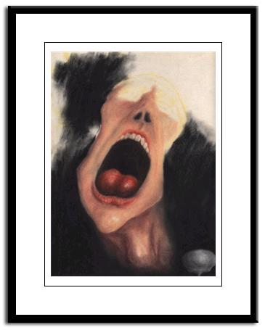
Building the Stack (Surely Not)
And it goes on and on

Slide 15

A Maze of Dependencies

Slide 16

We Need a Hero
The Usual Suspects
ASP.NET MVC Contrib

Slide 17

Gentoo Portage

Slide 18
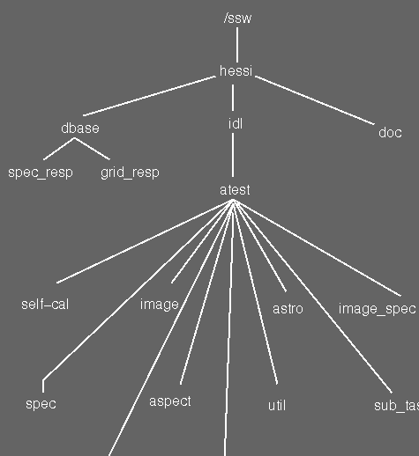
Package Tree Metaphor

Slide 19
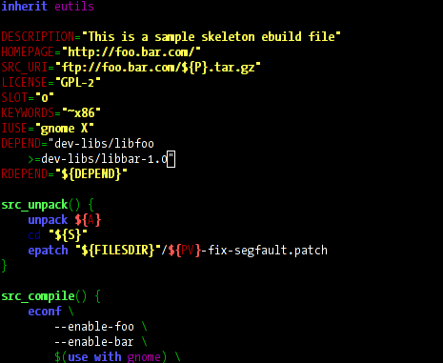
Ebuilds

Slide 20
Why not XML?
The Usual Suspects
ASP.NET MVC Contrib

Slide 21
XML is sooooo not cool anymore
The Usual Suspects
ASP.NET MVC Contrib

Slide 22
Why an Internal DSL?
The Usual Suspects
ASP.NET MVC Contrib

Slide 23
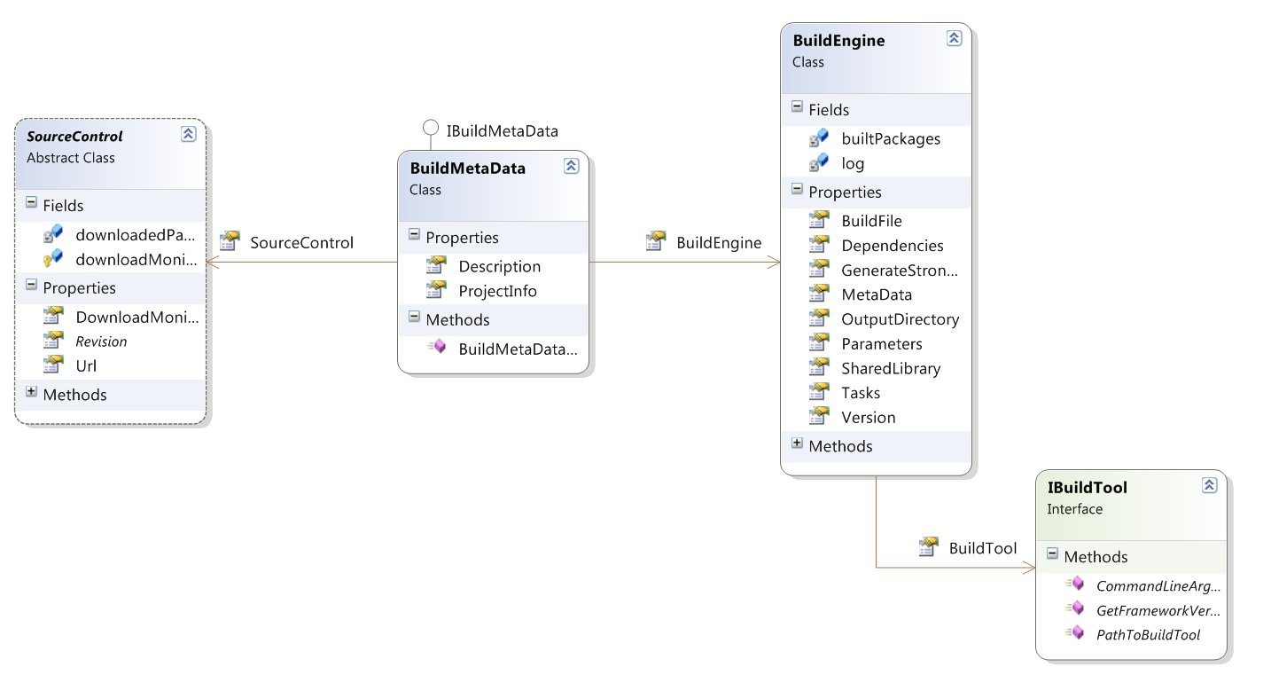
The Semantic Model

Slide 24
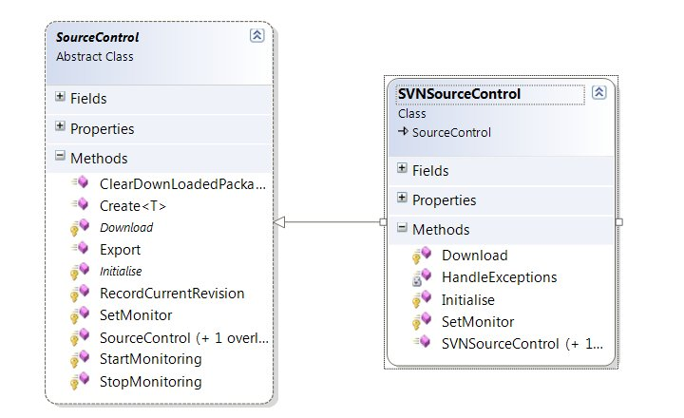
Source Control

Slide 25
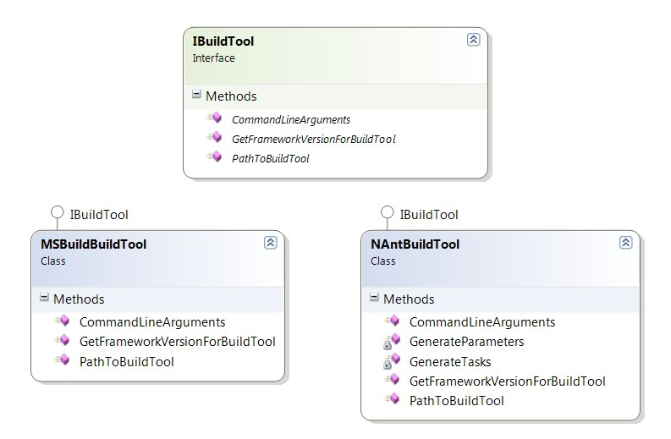
Build Engine

Slide 26


(Horn DSL)== Ebuild
vs.

Slide 27
Boo is.....
An object oriented statically typed language
An Open source project, released under the BSD license.
A python inspired language
A language with a focus on compiler extensibility

Slide 28
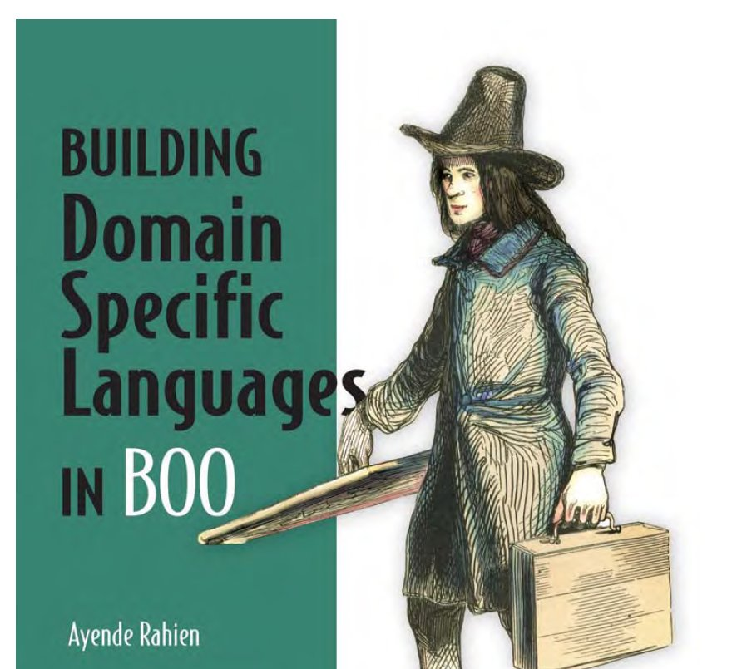
Duck Typing

Slide 29
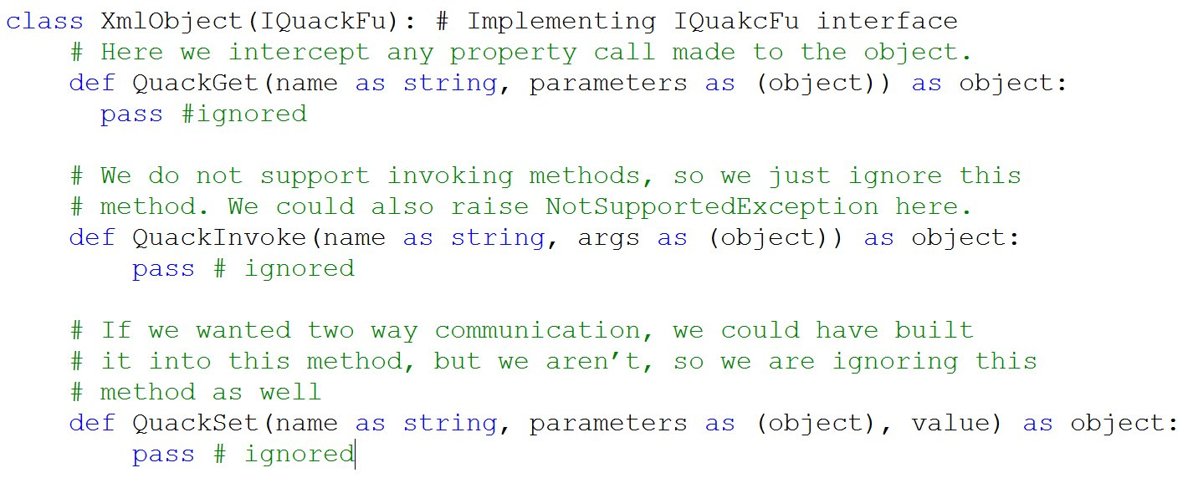
Duck Typing

Slide 30
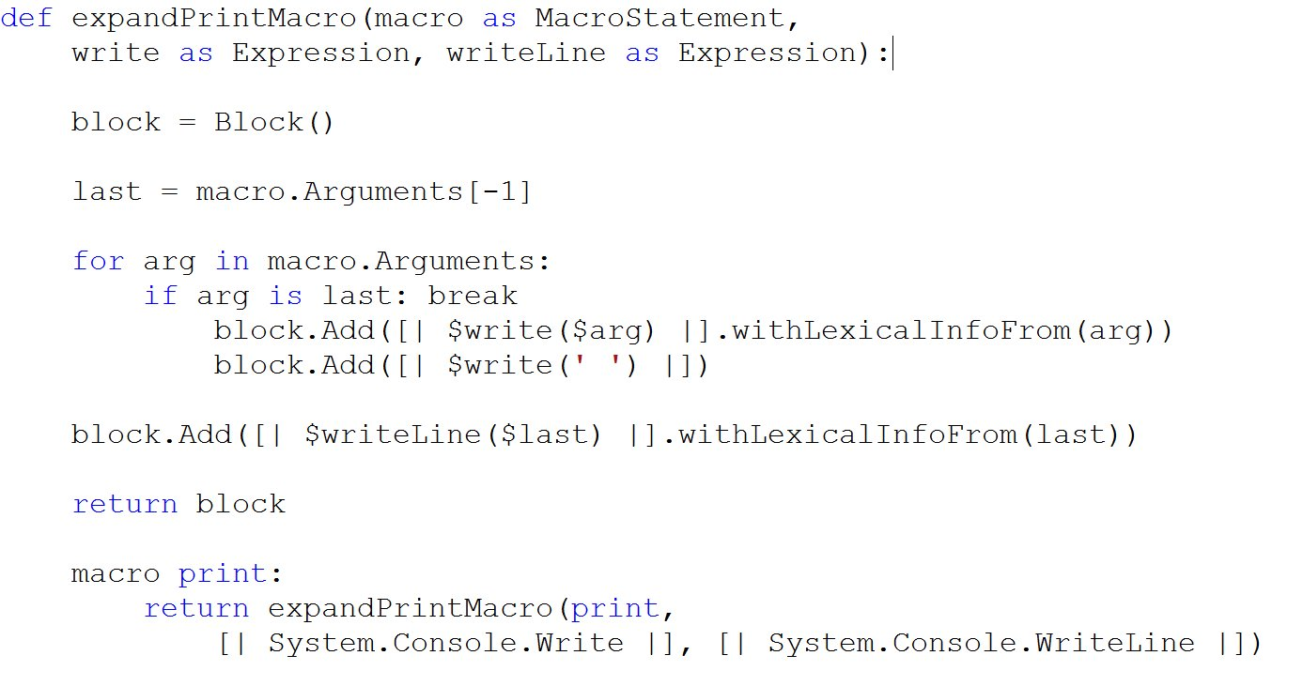
Macros

Slide 31
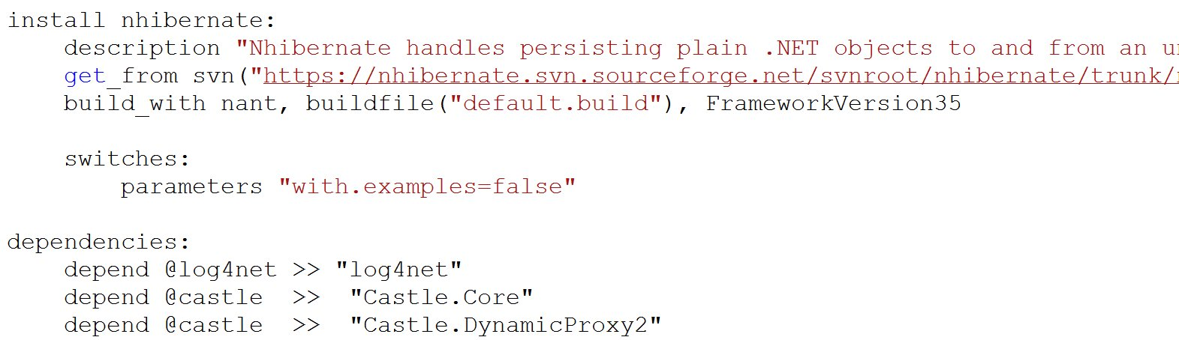
The Boo Horn DSL

Slide 32
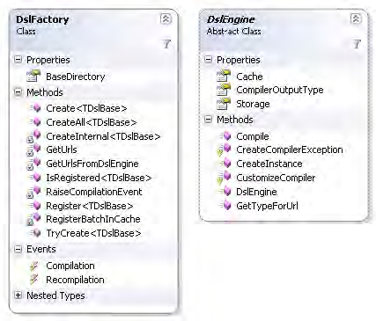
Rhino DSL

Slide 33
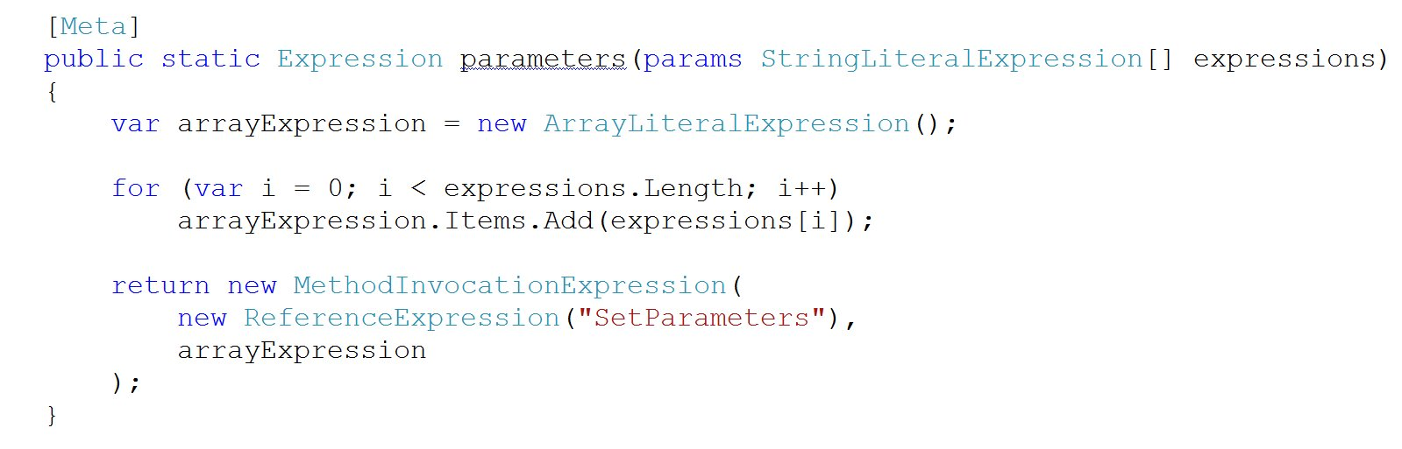
Meta Methods

Slide 34
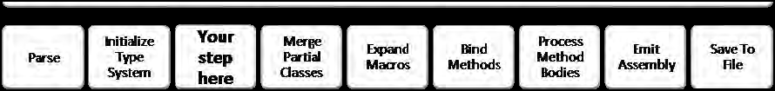
The Boo Compiler

Slide 35
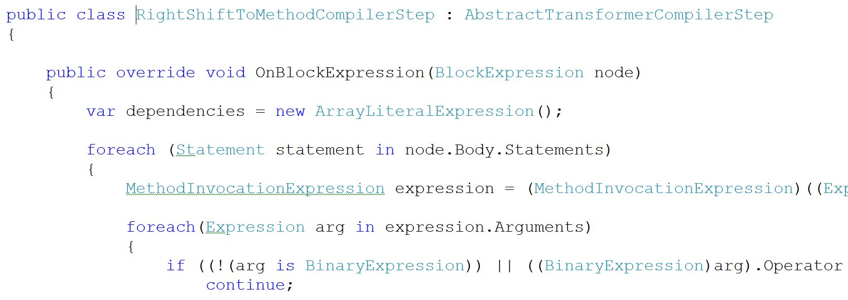
CustomizeCompiler Method

Slide 36
IronRuby
.NET implementation of the Ruby language
Seamless Integration with .NET libraries
Compatibility with the 1.8.x branch

Slide 37
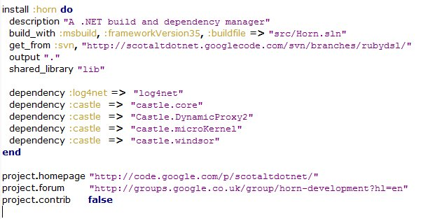
The IronRuby Horn DSL

Slide 38
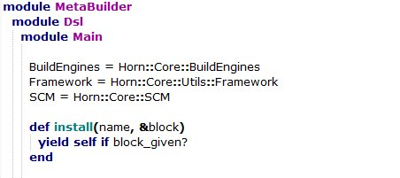
Mixins

Slide 39
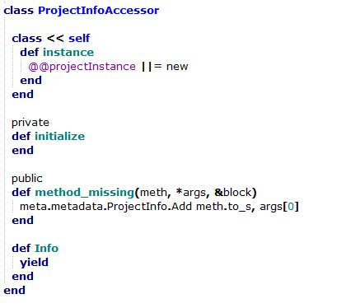
Method Missing

Slide 40
Current State of Horn
The Usual Suspects
ASP.NET MVC Contrib

Slide 41
Questions
The Usual Suspects
ASP.NET MVC Contrib

